Slide 1

Design Charrette Program
Prototypes
Webinar
Instagram: @smash.covid
Facebook: GSD Youth Access
to Mental Health Services Research
Twitter: @SMASHCOVID1
Email: smash.covid@camh.ca
Website: https://smashcovid.ca
July 31st, 2021

Slide 2



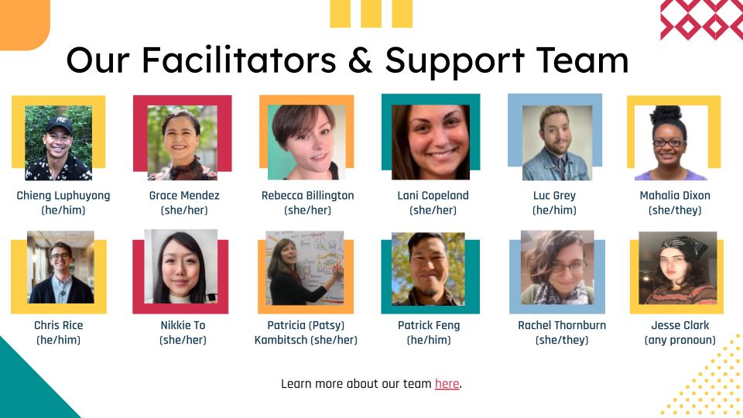
Acknowledgements
Dismantling Anti-Black racism
Addressing Institutional harm;
oppressive practices and unconscious bias
33 youth and young adults from across Ontario
Our design charrette program team
https://www.whose.land/en/

Slide 3

Agenda
Introduction to the co-design program
Presentation of Initial Prototype Concepts:
Personal Care & Maintenance
Rural Ontario Community of Queer & Trans Youth (ROCQY)
Education & Training for Service Providers
Transitional & After Care Services (Addressing Wait Times)
Accountability & Evaluation
Question & Answer Opportunity
Please write your question(s) or feedback in the Q&A box as
they come to you and we will respond to as many questions
as we can.
The slide images have largely been captured from the live programming
They may be illegible but can be made available for context if needed.
*This webinar is being recorded.
Creative by: Bethania Arts

Slide 4
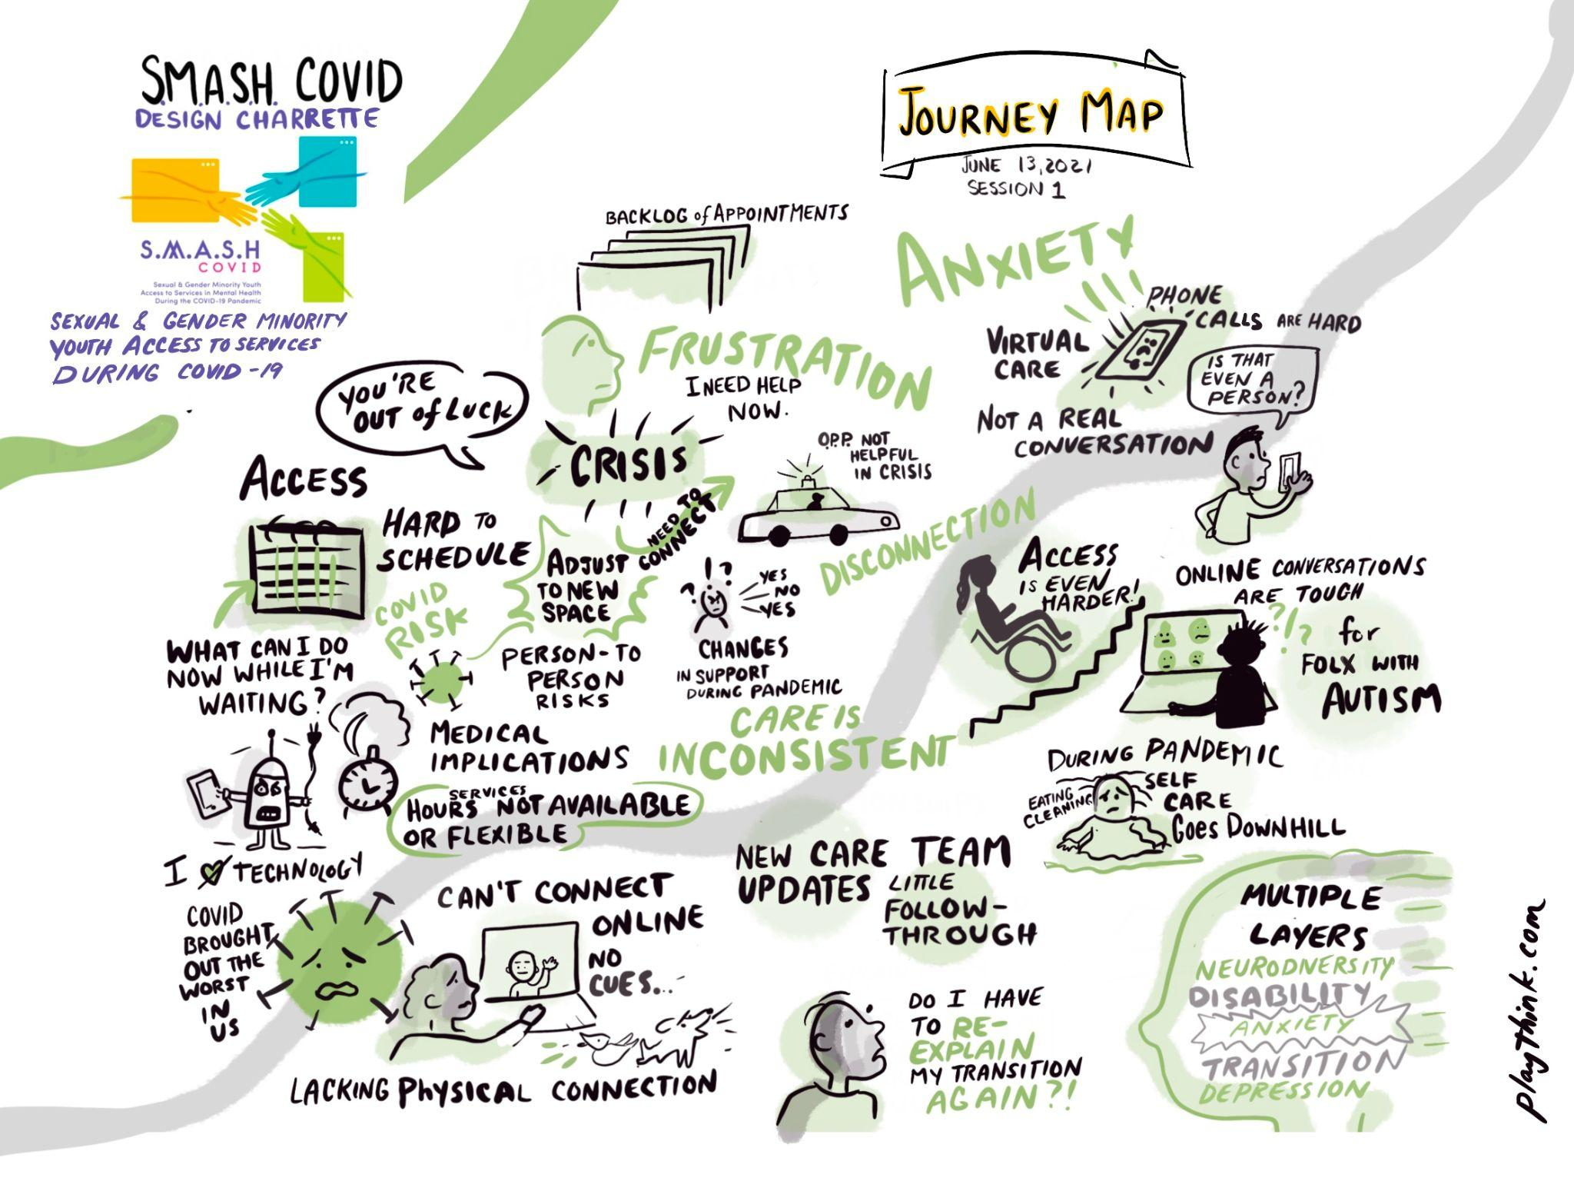
Design Charrette Program
Community-based participatory research project
Seeks to better understand the characteristics of gender and sexually diverse youth who are facing barriers to accessing mental health and substance use care services in the context of the COVID-19 pandemic.
Address the barriers that exist for queer and trans youth and young adults (16-29) seeking affirming mental health and substance use care services.
Series of design charrettes – intensely focused, three day sessions
Collaborative approach to create realistic and achievable designs that work.
Results will be used to inform policy and practice recommendations for the adaptation and development of:
  services, programs, resources and tools, offered by CAMH through Rainbow Services.
  additional collaboration with other providers, and community organizations
Individual journey-first lens and will directly support queer and trans youth and young adults navigating their wellness during and after the COVID-19 pandemic.
Co-Creating Knowledge - Idea & Prototyping - Refining & Presenting

Slide 5

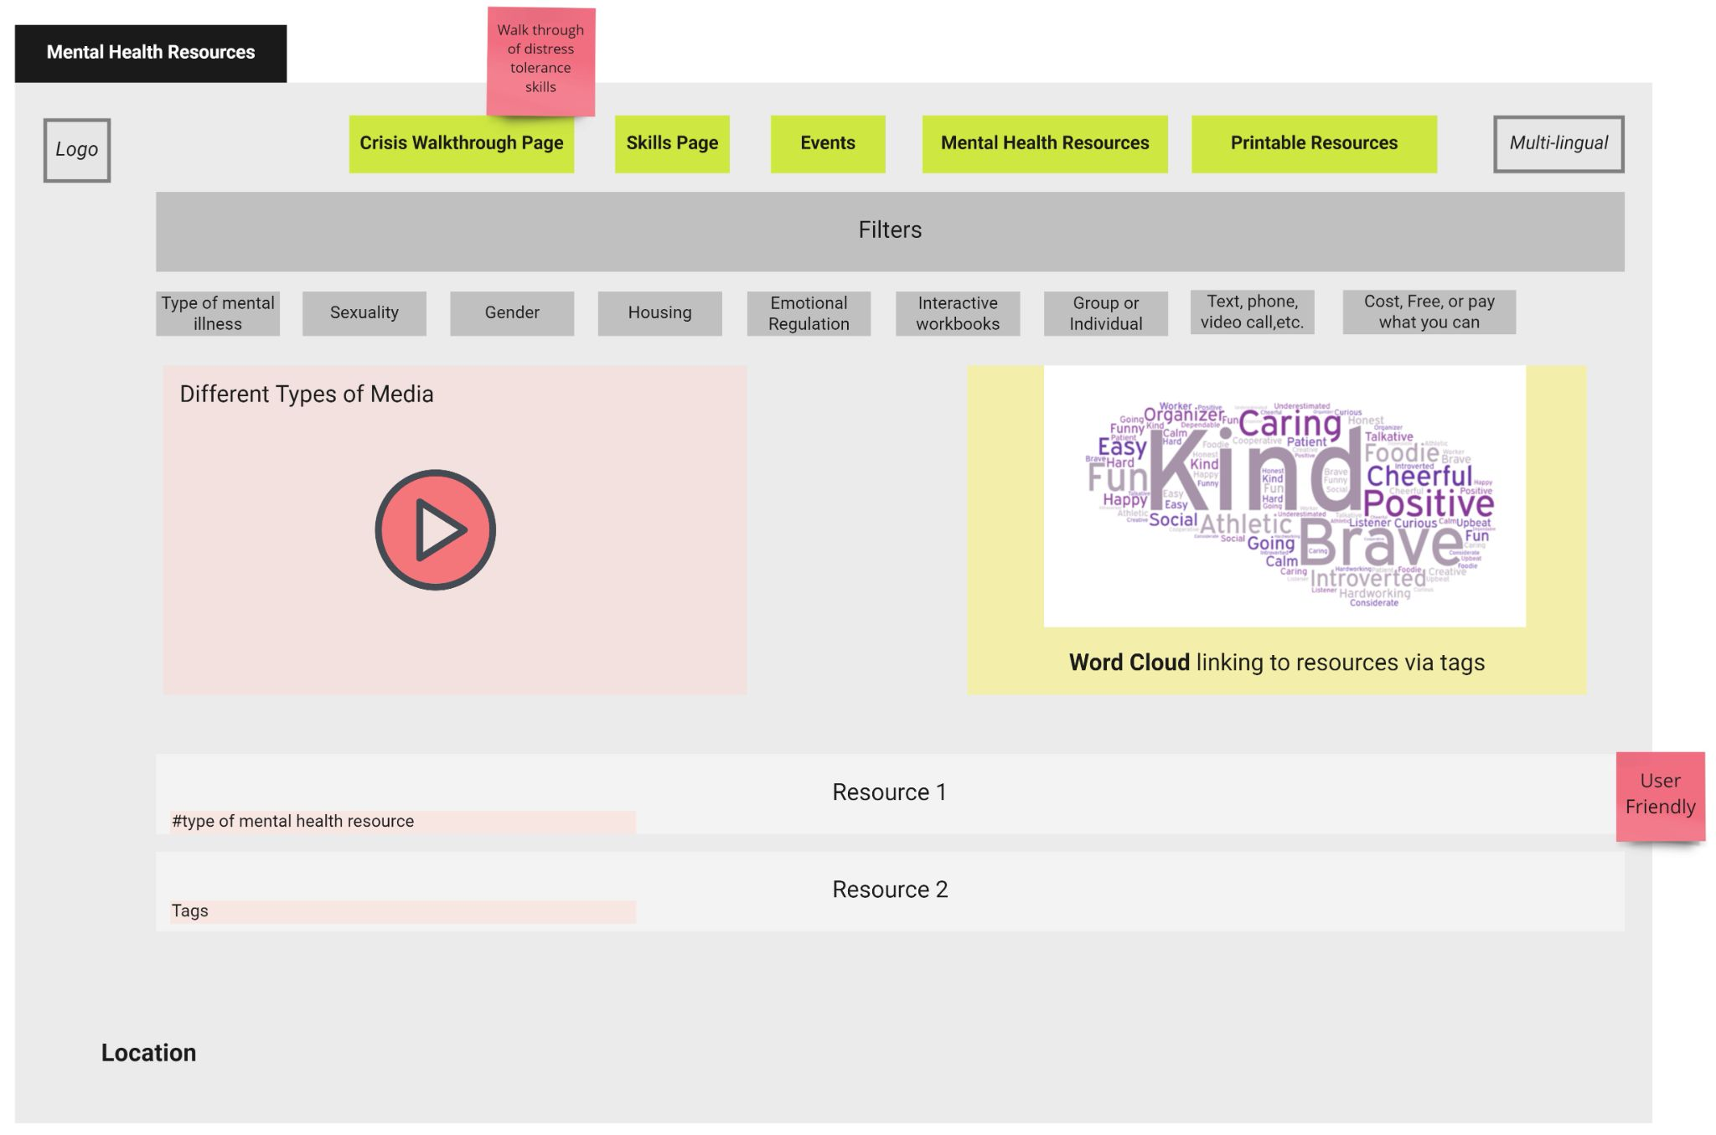
Theme 1: Personal Care & Maintenance (Self-Care)
How might we enable clients to support their own well-being outside of sessions and provide a centralized place to access self-care resources?
The idea is a centralized website for service providers and clients to access reliable, community-centered resources to support self-care outside of formal sessions. These resources can be accessed individually, or shared by service providers digitally or physically through print-outs and pamphlets.
Key Findings
Empowers clients and normalizes self-care
Removes the stigma that specific services are only for one thing (i.e., safe injection sites also offer many other helpful resources)
Strengthens communities through learning and education
Increases and diversifies the types of resources available
Prevents or reduces moments of crisis which can in turn reduce negative interactions with inappropriate crisis support such as with police

Slide 6
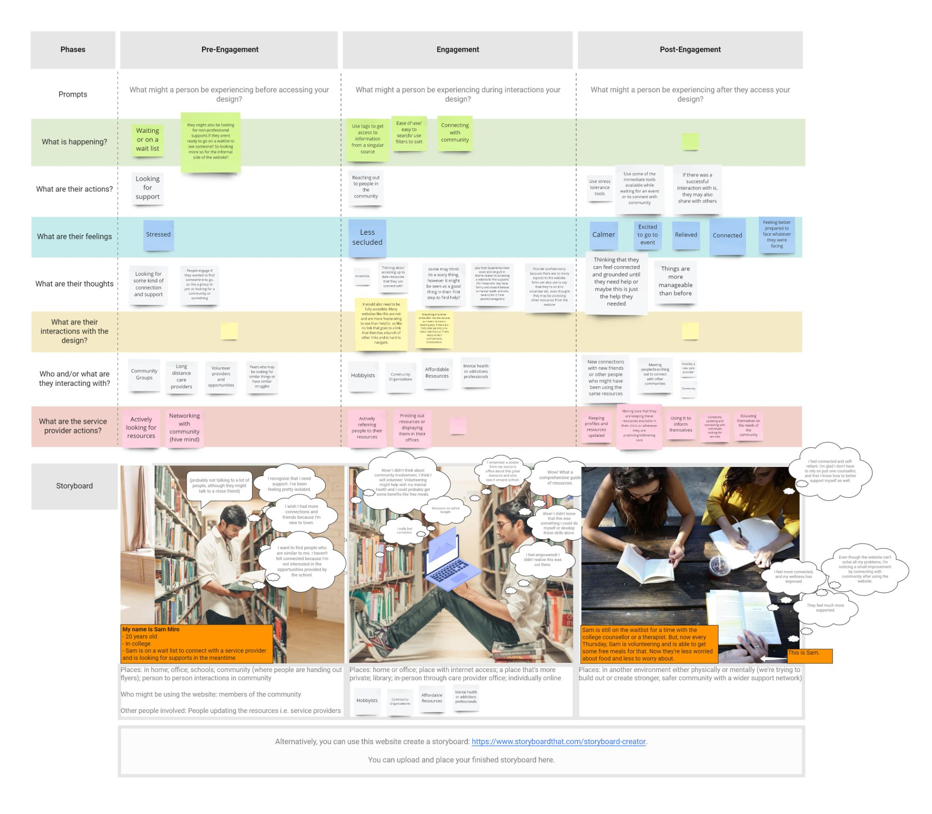
Theme 1: Personal Care & Maintenance (Self-Care)
How might we enable clients to support their own well-being outside of sessions and provide a centralized place to access self-care resources?
Actionable Items
Resources should include self-care, mental health, and substance use resources; skills development; crisis walkthroughs; community events; and volunteer opportunities
Create an approval process for community members to submit resources
Create a dedicated team for community engagement and outreach
Build community partnerships and share partner opportunities
Ensure service providers are proactively share resources
Ensure easy and simple usability across the website (i.e. accessible, supports a range of cognitive abilities, uses plain language, multilingual)
Format resources to be easily printable in black and white
Enable a range of ways to connect (i.e. in-person, phone, online, and different types of media such as videos)

Slide 7
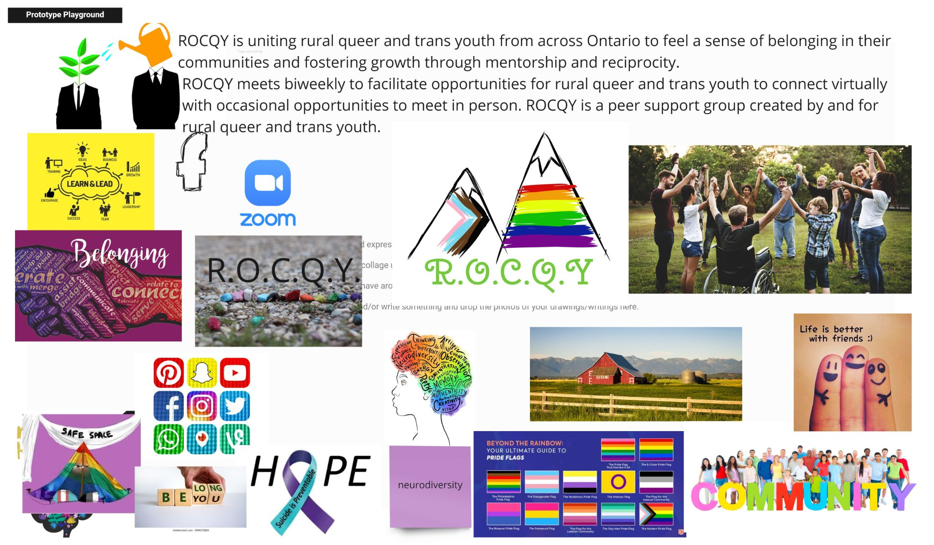
Theme 2: ROCQY – Peer Support Group for Rural Queer
& Trans Youth in Ontario (Rural Access)
How might we create more affirming communities where rural queer youth have a sense of belonging?
ROCQY is uniting rural queer and trans youth from across Ontario to feel a sense of belonging in their communities and fostering growth through mentorship and reciprocity. ROCQY meets biweekly to facilitate opportunities for rural queer and trans youth to connect virtually with occasional opportunities to meet in person. ROCQY is a peer support group created by and for rural queer and trans youth.
Key Findings
Improves mental health of youth in rural areas
Creates community connectedness and a sense of belonging in rural areas
Creates a safe space for everyone
Provides access to fun, social engagements that foster friendship
Reduces mental health crisis and suicide rates

Slide 8
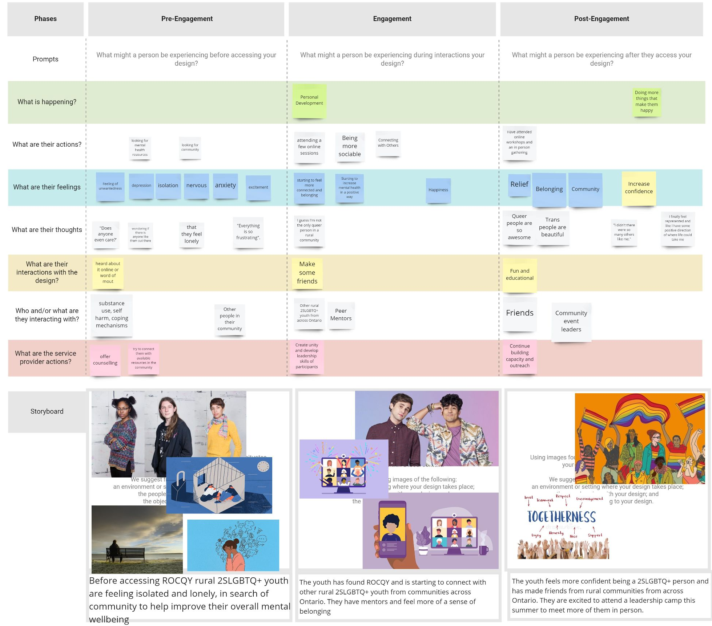
Theme 2: ROCQY – Peer Support Group for Rural Queer
& Trans Youth in Ontario (Rural Access)
How might we create more affirming communities where rural queer youth have a sense of belonging?
Actionable Items
Meetups should include social nights, anti-oppression education sessions, mental health training, 1 on 1 support options to meet with a facilitator on Zoom, safe sex and healthy relationship events
Connect with community event leaders
Provide additional external resources as needed (i.e. a list of queer and trans counsellors and trans-friendly doctors
Groups formed by ages (i.e. 14-18; 19-25)
Enable 26-29 age group members to mentor and facilitate younger groups
Include option for anonymity
Promote on a website, social media, and through local advertising in community spaces such as libraries

Slide 9
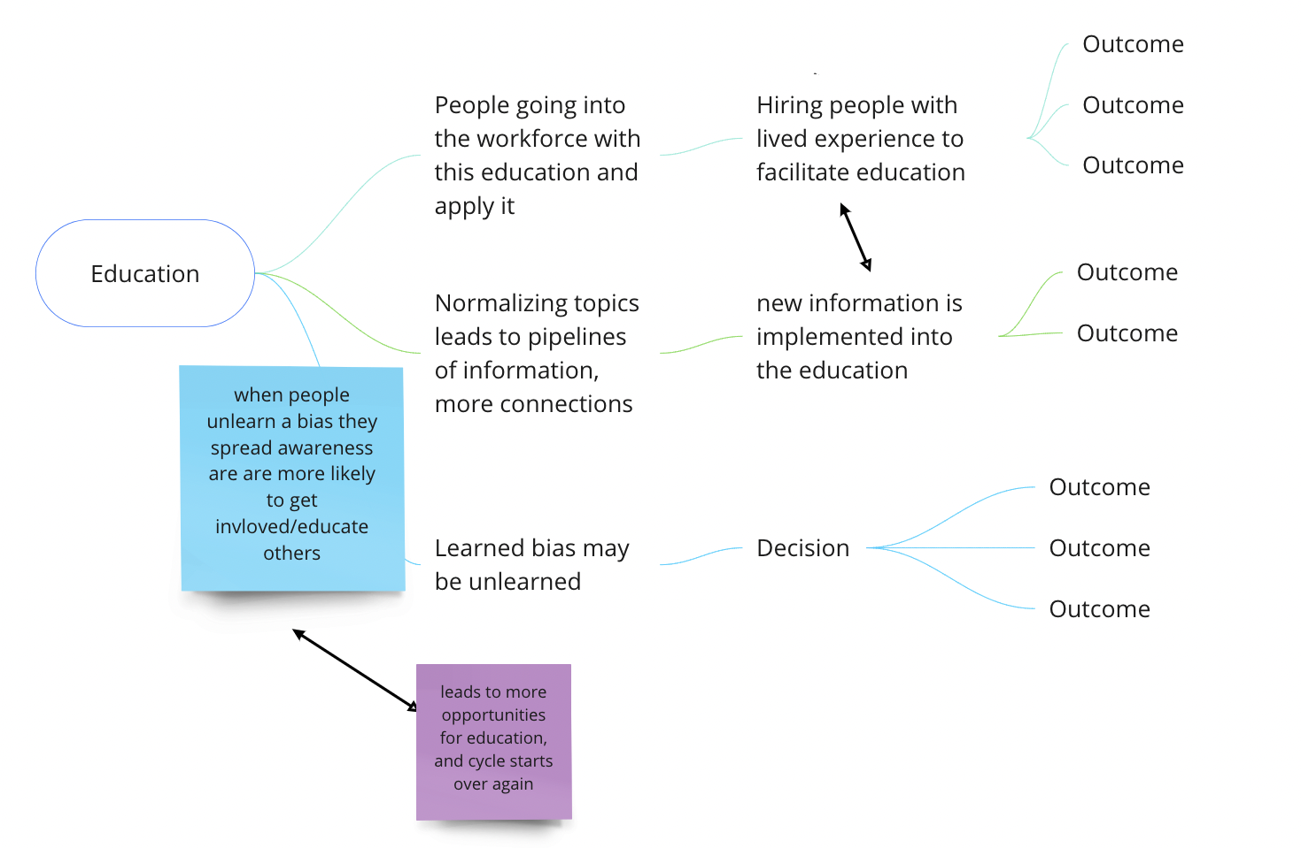
Theme 3: Education & Training For Service Providers First (Accessibility & Individualized Care)
How might we create more accessible and affirming spaces?
The idea is to re-design education and training for service providers and service users to improve accessibility, affirming services, outcomes, reduce stigma, and increase knowledge. This should be integrated across health education and major community touchpoints.
Key Findings
Addresses access barriers, user dignity, stigma, transphobia, racism, ableism, bias, etc.
Addresses gaps in doctor and service provider education
  Creates effective non-harmful support services
When people unlearn a bias, they spread awareness and are more likely to get involved and educate others

Slide 10
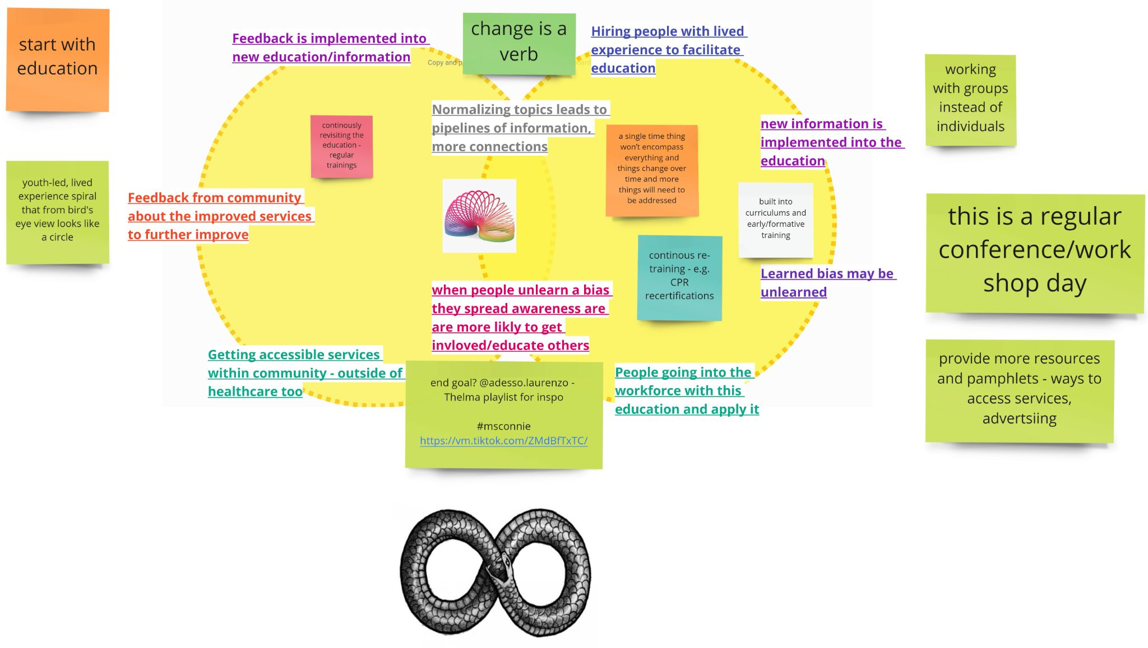
Theme 3: Education & Training For Service Providers First (Accessibility & Individualized Care)
How might we create more accessible and affirming spaces?
Actionable Items
Hire people with lived experience in leadership positions,
as staff, as educators, etc.
Continuously update curriculums, trainings and certifications
Implement continuous training and recertification instead of
one-time training
Ensure service providers consider accessibility and affirming care from the start
Provide more resources and pamphlets about ways to access services

Slide 11
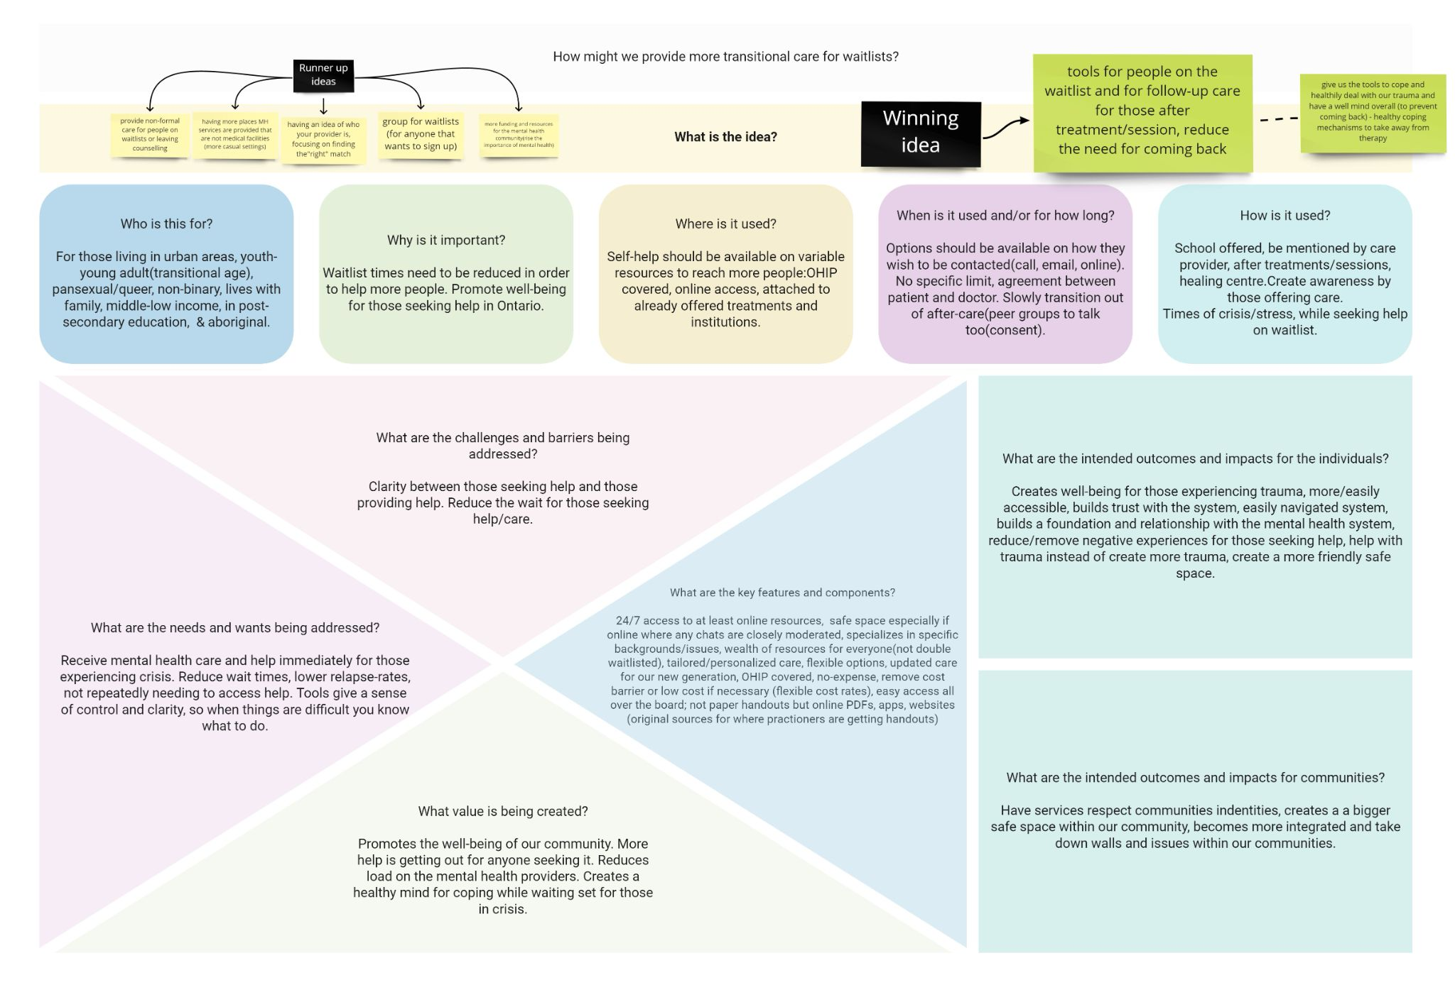
Theme 4: Transitional & After Care Services (Wait Times)
How might we provide more transitional care for waitlists?
The idea is to create tools for people on the waitlist and for follow-up care for those after treatment/sessions to reduce the need for returning to services. The target audience are youth and young adults living in urban areas who may be pansexual/ queer, non-binary, lives with family, middle-low income, in post-secondary education, and/or Indigenous. This will help people cope, deal with trauma in a healthy way, and have overall wellness.
Key Findings
Increased self-help resources lead to lower relapse-rates which in turn reduces waitlist times so more people can access care
Fosters well-being for those experiencing trauma
Reduces burden on mental health care providers
Resources and tools that suit individual needs provide people with a sense of control and clarity so when things are difficult, they know what to do
Promotes community well-being

Slide 12
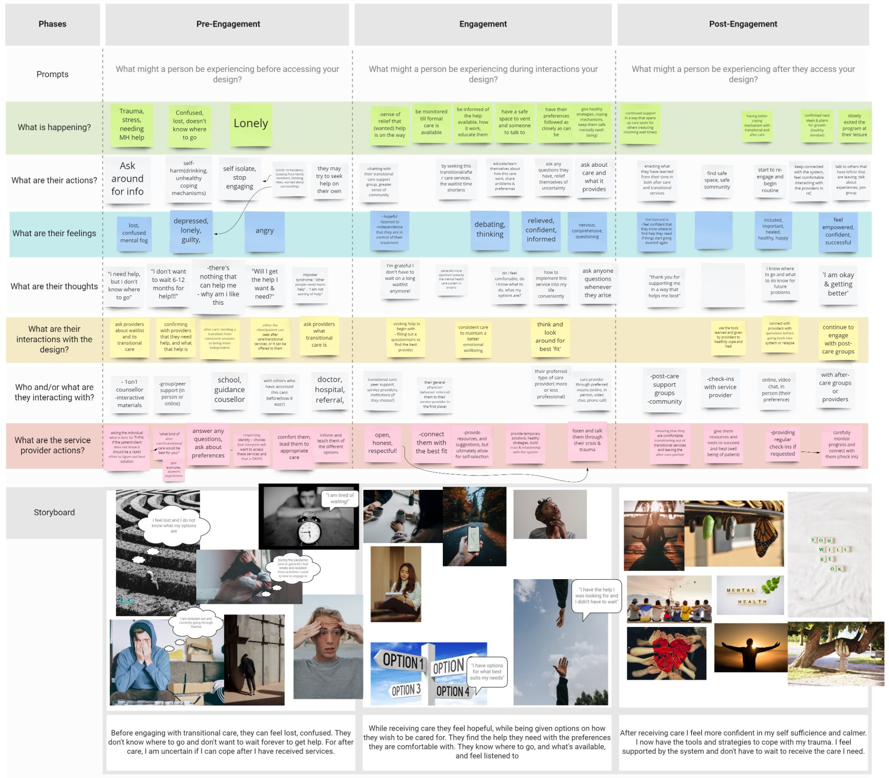
Theme 4: Transitional & After Care Services (Wait Times)
How might we provide more transitional care for waitlists?
Actionable Items
Provide people with tools and self-help resources before, between, during, and after care across a multitude of community outreach channels and flexible modes of access (i.e. OHIP covered, attached to current treatments and institutions, online access, apps, websites, pdfs)
Implement slow transitions out of care (i.e. connecting to peer groups). This should be discussed between the client and service provider.
Provide immediate support for those experiencing crisis
Provide 24/7 access to online resources for everyone, safe spaces online where any chats are closely moderated, support persons specialized in specific background/issues
Include original sources for where practitioners are getting resources
Ensure access to these resources don’t create double waitlists
Update care that aligns with new generation
Lower and remove financial barriers to access resources and services
Additional Ideas
Provide non-formal care for people on waitlists or leaving counselling
Create more places where mental health services are provided that are not medical facilities (more casual settings)
Provide information about providers, focusing on finding the “right” match

Slide 13

Theme 5: Health Care Safer & More Accessible (Accountability & Evaluation)
How might we make healthcare safer and more accessible for LGBTQ+ youth?

Slide 14
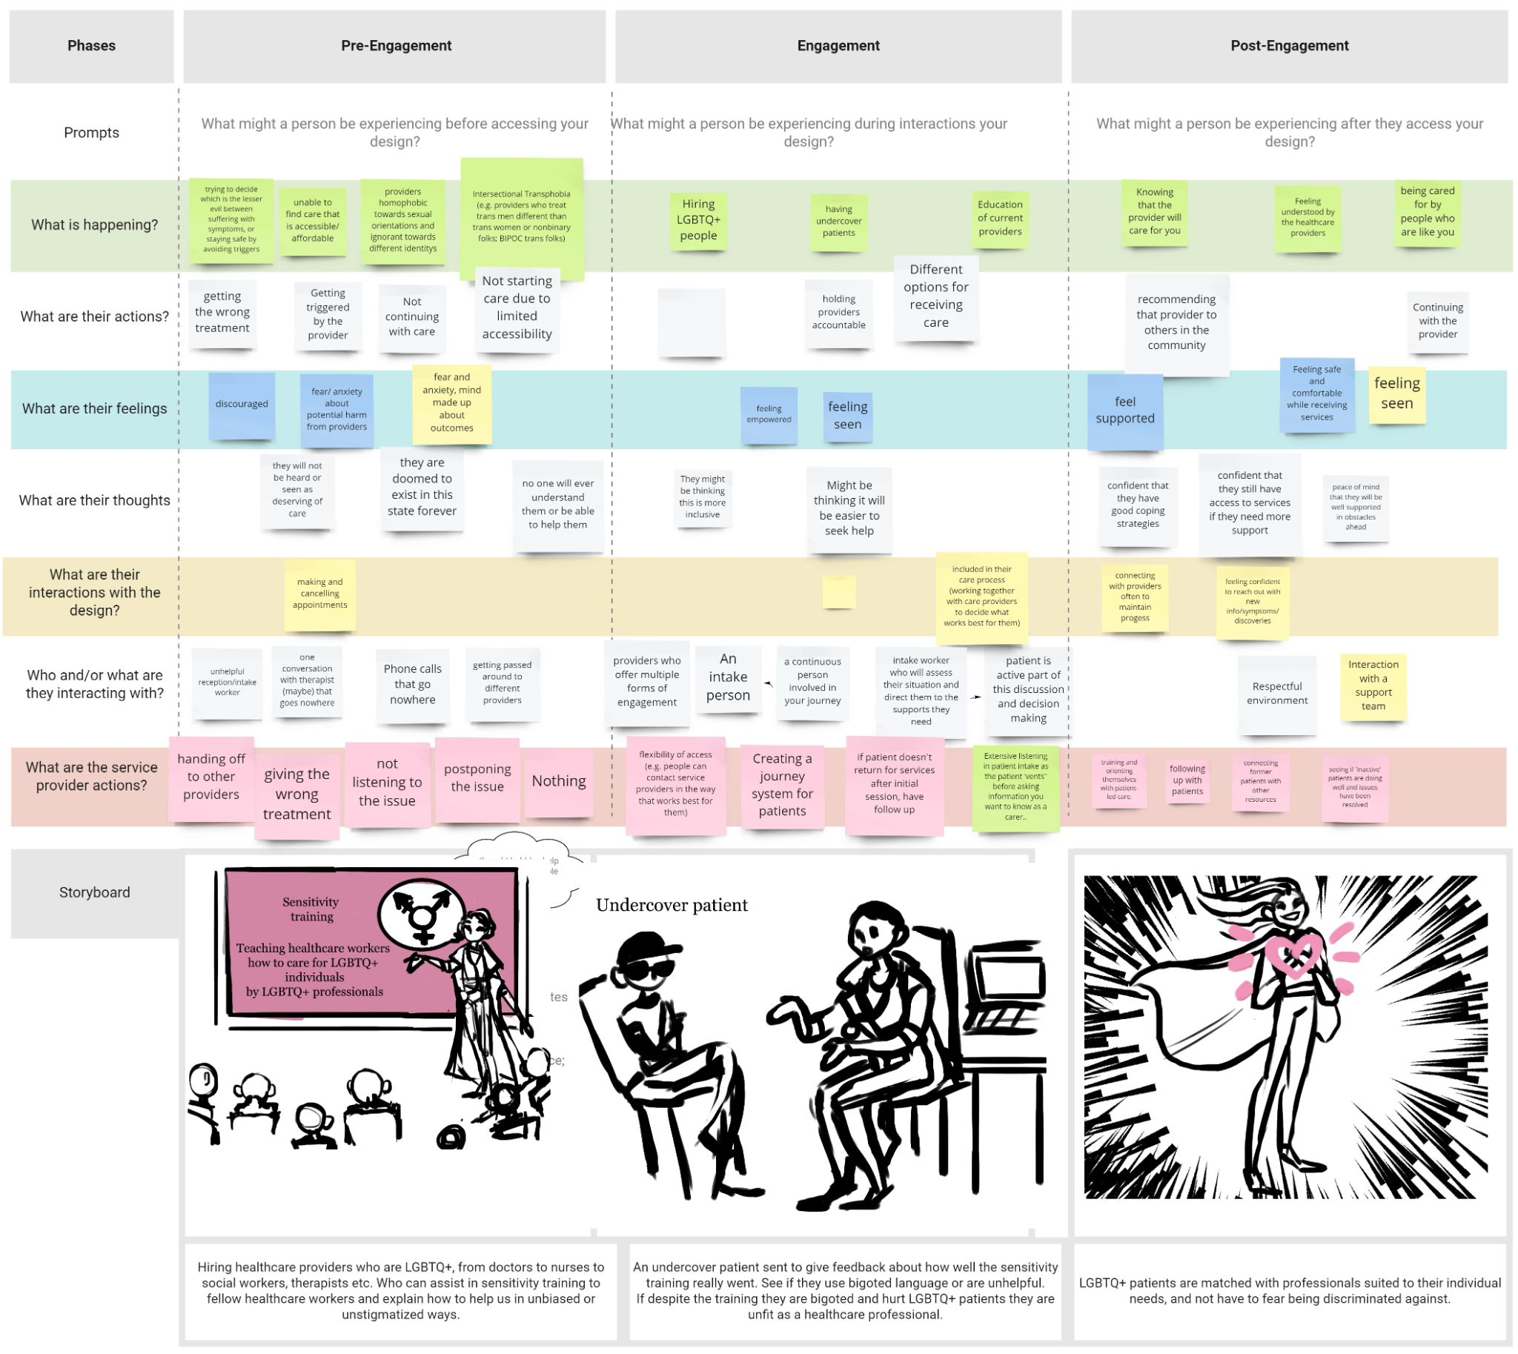
Theme 5: Health Care Safer & More Accessible (Accountability & Evaluation)
How might we make healthcare safer and more accessible for LGBTQ+ youth?

Slide 15
Question Session
We will respond to as many questions as we can.
If we cannot during the session, we will get in touch after the session.

Slide 16
Thank You
Instagram: @smash.covid
Facebook: GSD Youth Access
to Mental Health Services Research
Twitter: @SMASHCOVID1
Email: smash.covid@camh.ca
Website: https://smashcovid.ca

